Slide 1
Design Patterns
Mid-Semester Review

Slide 2
Principles and Patterns
Know the Principles
  Know how (and why) to use them
Know the Patterns
  Know how and when to use them
Ultimately, the principles are more important than the patterns
  Using patterns doesn’t make you a good designer
  Using principles does help you be a good designer

Slide 3
Design Patterns
Chapter 1

Slide 4
The Role of Inheritance
Key use is for Is-a relationships
  Refining types into subtypes
Has the side benefit of code sharing
  AND Concept sharing
  But this can be abused
Inheritance is overused or misused by novices
  Been there, done that, got the T-shirt, wore it out

Slide 5
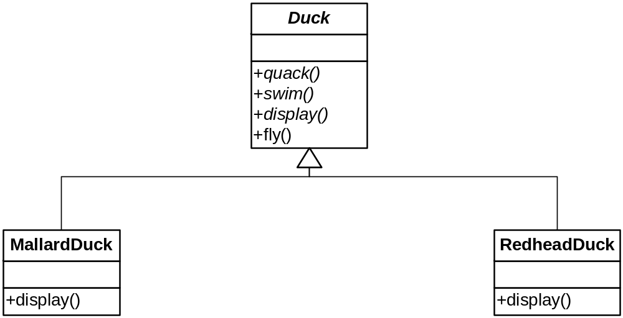

Slide 6
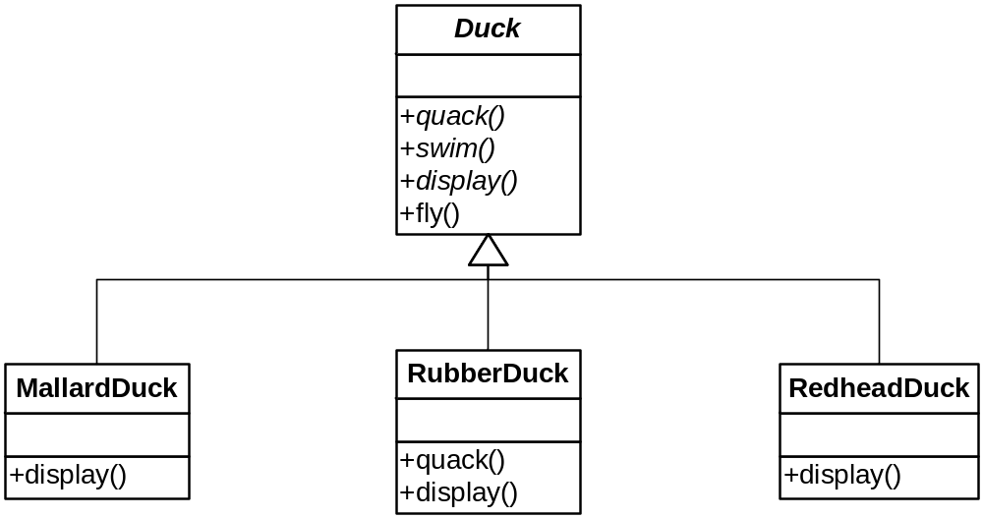

Slide 7
How Are We Doing?
Rubber Ducks don’t fly!
How are we going to correctly fit Rubber Ducks into the hierarchy?
We could override RubberDuck.fly( ) to do nothing

Slide 8
Inheritance is not The Answer
Not everything we’ve put in the Duck class should be inherited
  Some ducks don’t fly, etc.
Inheritance is specified statically (before runtime)
  It is too rigid to easily accommodate change like this
  We must change code

Slide 9
Design Principle
“Identify the aspects of your application that vary and separate them from what stays the same.”
You decide what varies and what doesn’t
  Not cast in stone (humans still required!)
This principle underlies most patterns

Slide 10
Commonality/Variability Analysis
You already understand this in part
  Polymorphism via virtual functions separates what changes (the implementation) from what stays the same (the interface)
But there are other ways to provide the needed separation
  Subtype polymorphism is only one narrow manifestation of this principle
  Finding just the right composition is as much art as science
    In other words, humans are still required

Slide 11
Separating What Varies
Let’s see what happens is we encapsulate Flying and Quacking behaviors in their own classes
In other words, the implementations of these behaviors go into their own respective hierarchies
  There still needs to be something in Duck that ultimately invokes these behaviors, of course
  That is, the interface is still there

Slide 12
Design Principle
“Program to an interface, not an implementation”
So, we need to further separate the two…

Slide 13
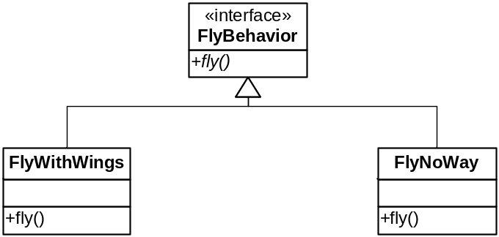
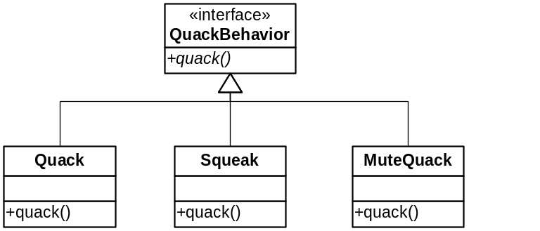
The Varying Behaviors

Slide 14
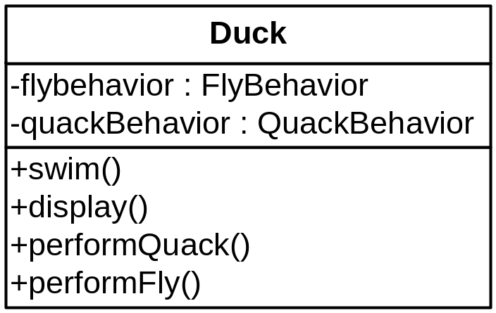
Glue the Behaviors in Appropriately
The Duck class will hold supertype references to concrete behavior objects

Slide 15
Benefits of This Design
We can add new behaviors without affecting the Duck class
  Simple polymorphism does this too, but this design puts the behaviors in a single place (DRY!)
Also, these classes are independent of Duck and can be used in other contexts

Slide 16
Design Principle
“Favor Composition over Inheritance”
Of course, we used inheritance
  But not for everything
  Only when we needed an “is-a” or “implements” relationship
Composition is more flexible
  Resist the urge to over-classify via hierarchies

Slide 17
Pattern Truths
“Patterns guide humans, not machines”
  Hence not connected to code generation or other automated tools
  Cannot replace programmers!
Patterns will not turn programmers into experts
  Unless they use them over time and absorb the underlying principles

Slide 18
Design Patterns
Chapter 2

Slide 19
Question
Clients generally obtain information from objects of interest (the “subject”) by calling the subject’s methods
But how can the client keep current if the subject keeps changing?
  How do they know when to query the subject?

Slide 20
The Observer Pattern
Allows an object to be tracked (observed) by an arbitrary number of observers with a minimum of coupling
AKA “Publisher-Subscriber”
Think of newspapers or online alerts (like RSS feeds)
  You subscribe to get notifications
  You can unsubscribe at any time

Slide 21
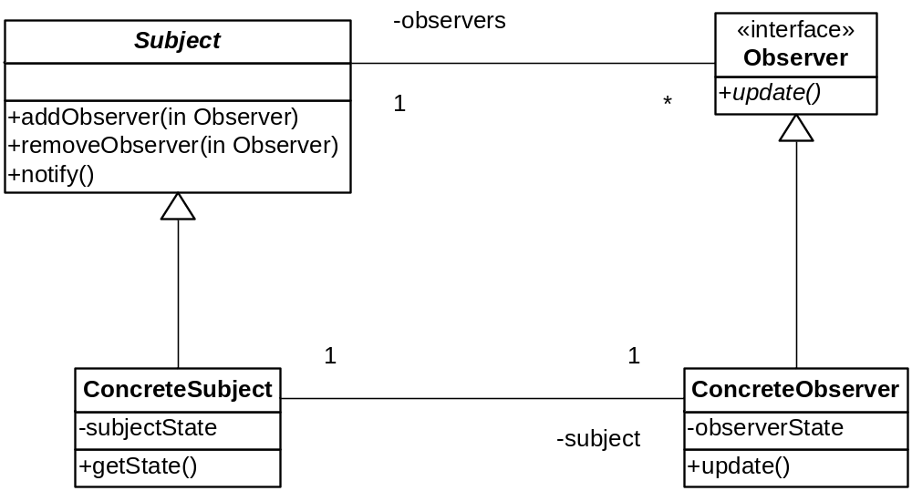
The Observer Pattern
Sketch

Slide 22
The Observer Pattern
Advantages
Both sides are insulated form implementation details
  Details in concrete classes can vary independently
New observers can be added at will
Subject doesn’t change when new types of observers are created

Slide 23
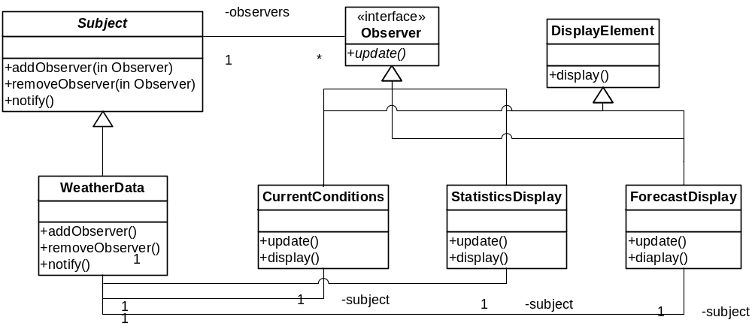
Weather-O-Rama with Observer

Slide 24
Implementation Notes
The Subject maintains a list of Observers
  Added when observers register
All observers are notified
  When?
  What about composite updates?
  What about threading issues?
Observers keep a reference to the subject
  So they can unsubscribe
    By calling subject.removeObserver(this)
    So they can query state

Slide 25
Notifying Observers
The notify method calls update for each observer
How should observers respond?
What about passing data to the observers?

Slide 26
The Pull Model
The Subject just notifies the observers without passing any data
The Observers then call getter methods on the Subject for data
  Observers must know the interface for Subject
  Have to figure out what changed themselves

Slide 27
The Push Model
The Subject passes data in a parameter in update
  As a single instance of Object in Java
    For genericity
    Must use an explicit class or a template parameter in C++
Observers must know how to cast and/or interpret this data
Makes Observers less reusable
  More coupling with Subject

Slide 28
Design Principle
“Strive for loosely-coupled designs between objects that interact.”

Slide 29
Design Patterns
Chapter 3

Slide 30
OO Design Redux
Consider a GUI type named Window
  Unadorned, but functional
Now suppose we want some more full-featured windows
  Bordered, scrollable, etc.
How do we design this?

Slide 31
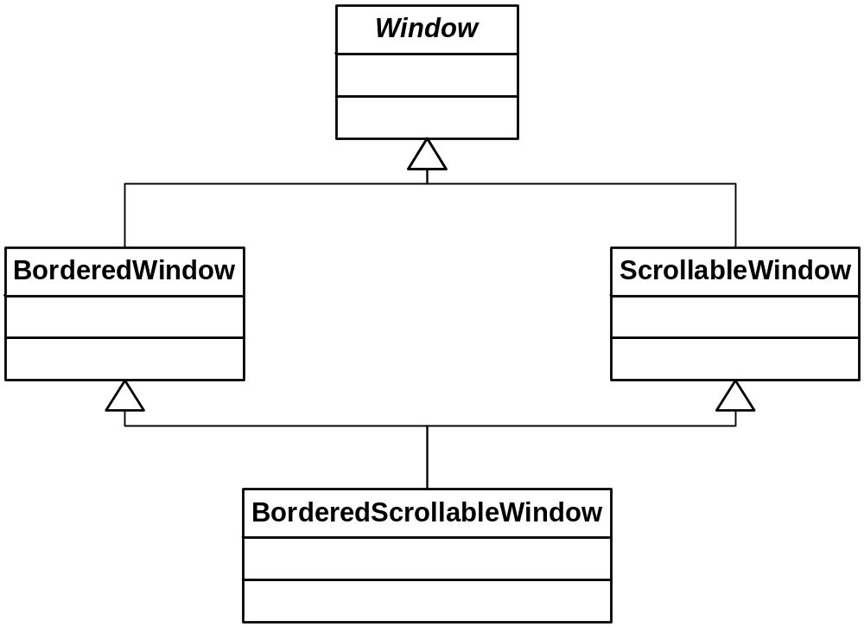
Our Simple Hierarchy

Slide 32
Problem #2
What if we need to add another important, independent windowing feature?
  WhizbangWindow
What impact does this have on the hierarchy?

Slide 33
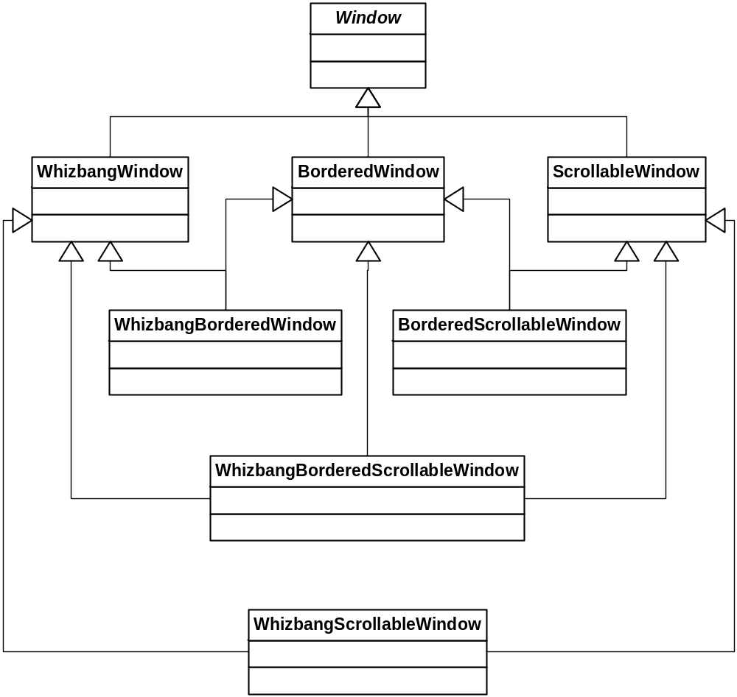
Hierarchical “Progress”

Slide 34
Starbuzz Coffee
Has 4 concrete specializations of the Beverage type
  HouseBlend, DarkRoast, Decaf, Espresso
Also, there are four “features” that can adorn these drinks
  SteamedMilk, Soy, Mocha, WhippedMilk
64 clunky classes to look forward to! ( see page 81)

Slide 35
Evaluating Take #2
Beverage.cost( ) must check for the presence of each condiment
As new condiments arrive, Beverage’s code must change noticeably
  New fields and methods, additional processing
We would rather be able to add new condiments without changing Beverage at all!
  “Separate what varies”
  At runtime! (Trivial in Smalltalk, Python, or Ruby)

Slide 36
The Open-Closed Principle
Classes should be open for extension but closed for modification
Say what?
It is better to extend a class by not changing its code
  Clients dependent on it will have to change
  New bugs can emerge
  We have seen how inheritance often violates this principle
  But there are other ways to extend classes!
    Composing a wrapper, for instance

Slide 37
The Decorator Pattern
Structural
Intent:
  Add additional responsibilities to an object dynamically.
Context:
  Applies when clients program to an abstraction (not its subtypes). A decorator can be used in the same way as its subject (“is-a”). The set of additional responsibilities can be open-ended. Existing subject code does not change. Multiple decorators can be combined sequentially.
Solution:
  The Decorator implements the same interface as the abstraction. It manages a concrete instance of the abstraction via composition, and adds additional functionality. It calls the managed object’s methods and combines the result with the additional functionality.

Slide 38
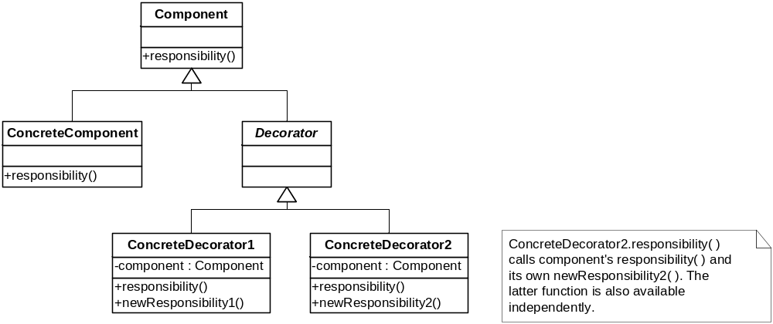
Class Sketch
⬅ Sometimes optional

Slide 39
Decorators and Starbuzz
Suppose you want a DarkRoast Mocha Whip
The base component object is DarkRoast
You can wrap it in a Mocha decorator
  Or do Whip first, shouldn’t matter
Then wrap it in a Whip decorator
  Whip.cost( ) calls Mocha.cost( ) which calls DarkRoast.cost( )
  The total cost is accumulated and returned
The composite object can be used anywhere a Beverage can!

Slide 40
Design Patterns
Chapter 4

Slide 41
Controlling Object Creation
Ultimately, the exact object of a type must be known in order to create it (duh)
  Foo f;
  Bar b = new Bar(“baz”);
But this violates an important principle:
  Program to an interface, not an implementation
    Or, program to abstractions, not concrete types
Concrete object creation is best localized in one place
  So introducing new types doesn’t cause maintenance trauma

Slide 42
Dependency Inversion Principle www.objectmentor.com/resources/articles/dip.pdf
High-level modules should not depend on low-level modules
  Both should depend on abstractions
Abstractions should not depend on details
  Details should depend on abstractions
Why?
  So clients of abstractions are insulated from changes

Slide 43
Rules of Thumb for the DIP
No variable in an abstraction should hold a pointer to a concrete class
No class should derive from a concrete class
No method should override an implemented method of any of its base classes
  Only override abstract methods
These rules can’t be followed all the time!
  Emphasis on thumb :-)
  The key is how volatile the lower-level module is

Slide 44
Factories
Allow a (client) higher-level module to defer the details of object creation to its (server) lower-level service module
  Including determining the type of the object that needs to be created
“Polymorphic Factory”

Slide 45
More Pizza in Objectville
public Pizza orderPizza(String type) {
Pizza pizza;
if (type.equals(“cheese”))
pizza = new CheesePizza();
else if (type.equals(“greek”))
pizza = new GreekPizza();
(etc.)
pizza.prepare();
pizza.bake();
pizza.cut();
pizza.box();
return pizza;
}

Slide 46
Here We Go Again!
As new pizza types arrive, we must change this code
  If this is the only place it occurs, it’s not the end of the world
  Nonetheless, let’s try to…
… Separate those things that vary from those that don’t (again)
And now that we know about Open-Closed:
  Let’s try to make this code extensible while being closed to modification

Slide 47
A Pizza-Creating Class
public class SimplePizzaFactory {
public Pizza createPizza(String type) {
Pizza pizza = null;
if (type.equals("cheese")) {
pizza = new CheesePizza();
} else if (type.equals("pepperoni")) {
pizza = new PepperoniPizza();
} else if (type.equals("clam")) {
pizza = new ClamPizza();
} else if (type.equals("veggie")) {
pizza = new VeggiePizza();
}
return pizza;
}
}

Slide 48
Refactoring orderPizza( )
public class PizzaStore {
SimplePizzaFactory factory;
public PizzaStore(SimplePizzaFactory factory) {
this.factory = factory;
}
public Pizza orderPizza(String type) {
Pizza pizza = factory.createPizza(type);
pizza.prepare();
pizza.bake();
pizza.cut();
pizza.box();
return pizza;
}
}

Slide 49
And Now… Life Happens
There are different “styles” of pizza
  A New York style Cheese differs from a Chicago style
  Your business savvy says you should support both

Slide 50
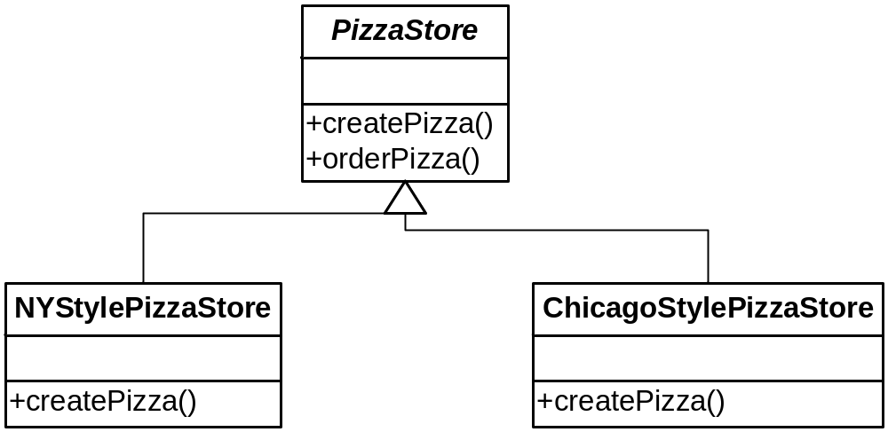
A Polymorphic Factory
The correct createPizza( ) is called by polymorphism.

Slide 51
Using the Factory Method
public abstract class PizzaStore {
protected abstract Pizza createPizza(String type);
public Pizza orderPizza(String type) {
Pizza pizza = createPizza(type);
pizza.prepare();
pizza.bake();
pizza.cut();
pizza.box();
return pizza;
}
}

Slide 52
But Not Much Change Here
public class NYPizzaStore extends PizzaStore {
Pizza createPizza(String item) {
if (item.equals("cheese")) {
return new NYStyleCheesePizza();
} else if (item.equals("veggie")) {
return new NYStyleVeggiePizza();
} else if (item.equals("clam")) {
return new NYStyleClamPizza();
} else if (item.equals("pepperoni")) {
return new NYStylePepperoniPizza();
} else return null;
}
}
That’s the breaks with polymorphic factories. It allows us to vary the concrete Pizza type in one place, however.

Slide 53
Factory Method
Creational
Intent:
  Lets a class defer object instantiation to subclasses.
Context:
  A module uses an abstraction, so you want to follow the DIP and not depend on concrete details. The client module may not even know which class to instantiate.
Solution:
  Define an interface for creating a family of objects, but let subclasses decide which class to instantiate.

Slide 54
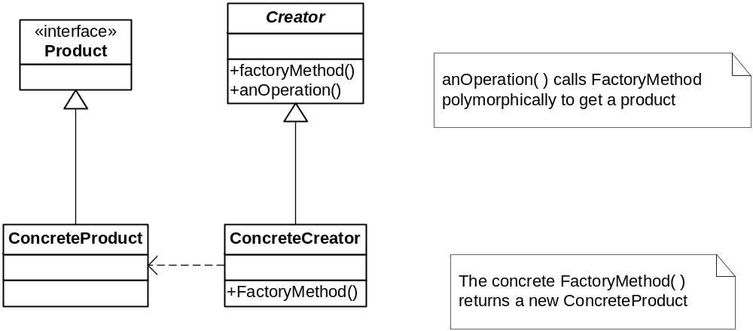
Factory Method
Class Sketch

Slide 55
More Changes Afoot
Franchisees have been using inferior ingredients
  Infidels!
So you want more control over how pizzas get made
  While still allowing for stylistic differences
So we’re drilling down a little deeper to how pizzas are actually made

Slide 56
Controlling Ingredients
Pizza ingredients come in families:
  Sauce, cheese, dough, toppings
  They all have these components
    But with differences (e.g., parmesan vs. mozarella)
You want to ship ingredients together
So we need a factory to build families of ingredients
  Note: my diagrams differ from the book’s
  They’re better!

Slide 57
PizzaIngredientFactory
Will have a factory method for each ingredient type
  createDough, createSauce, etc.
These will be specialized in concrete subclasses by region
  NYPizzaIngredientFactory, etc.
So we’re talking families of factory methods

Slide 58
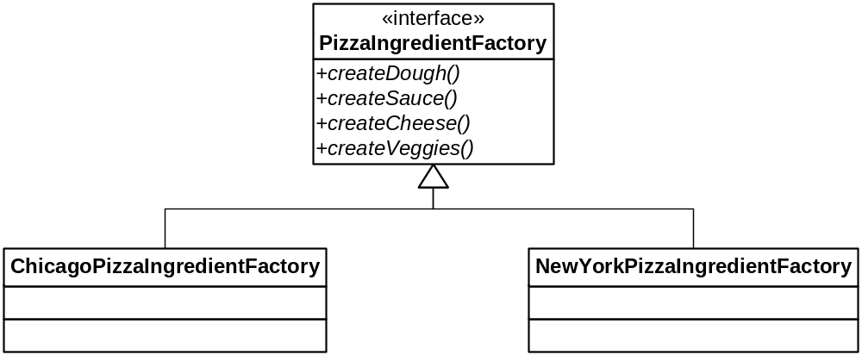
The Ingredient Factories

Slide 59
Getting the Right Ingredients
Somewhere (in prepare for now) we say:
  sauce = ingredientFactory.createSauce( );
  cheese = ingredientFactory.createCheese( );
  etc.
These are fields in Pizza
  Before we just had a list called toppings
  Now we’re taking over what those toppings are

Slide 60
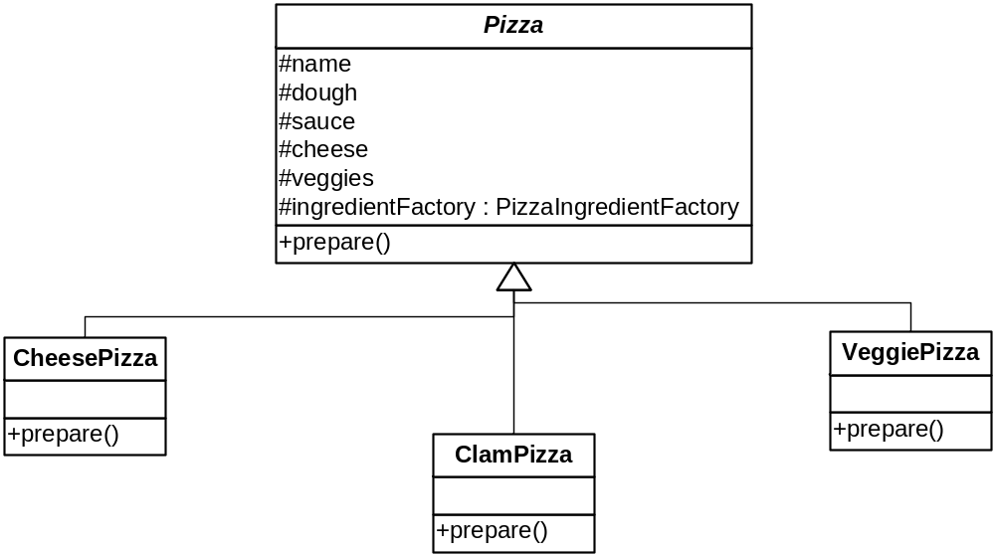
The Pizza Hierarchy
No more NYCheesePizza, ChicagoCheesePizza…

Slide 61
What about PizzaStore?
This is what establishes the ingredientFactory
  And passes it to the pizza it creates with its (independent) Factory Method

Slide 62
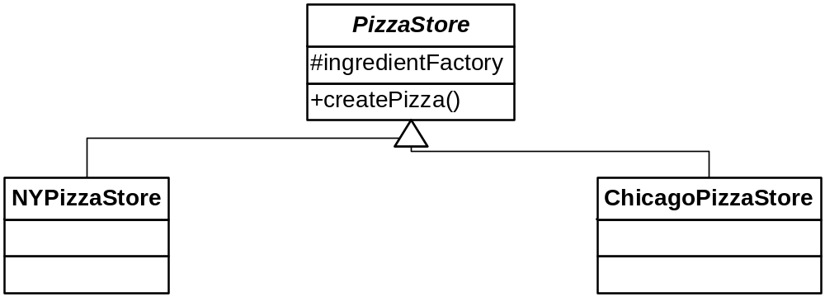
The PizzaStore Hierarchy

Slide 63
NYPizzaStore
Setting up A parametric factory method
public class NYPizzaStore : extends PizzaStore {
PizzaIngredientFactory ingredientFactory;
public NYPizzaStore() {
ingredientFactory = new NYPizzaIngredientFactory();
}
…

Slide 64
NYPizzaStore.createPizza( )
A parametric factory method
protected Pizza createPizza(String item) {
Pizza pizza = null;
if (item.equals("cheese")) {
pizza = new CheesePizza(ingredientFactory);
pizza.setName("New York Style Cheese Pizza");
} else if (item.equals("veggie")) {
pizza = new VeggiePizza(ingredientFactory);
pizza.setName("New York Style Veggie Pizza");
} else if (item.equals("clam")) {
pizza = new ClamPizza(ingredientFactory);
pizza.setName("New York Style Clam Pizza");
} else if (item.equals("pepperoni")) {
pizza = new PepperoniPizza(ingredientFactory);
pizza.setName("New York Style Pepperoni Pizza");
}
return pizza;
}

Slide 65
Abstract Factory
Creational
Intent:
  Provide an interface for creating families of related or dependent objects without specifying their concrete classes.
Context:
  Your system needs to be configured with one of multiple families of products, but it should be independent of how its products are created and assembled.
Solution:
  Declare an abstract type with methods for creating each type of component. Subclasses create the correct concrete types for the family they represent.

Slide 66

Abstract Factory
Class Sketch

Slide 67
Factory Method vs. Abstract Factory
Factory Method creates a single object
  It can decay into a single static method
  The abstract root often has a processing method that calls the factory method
    i.e., the factory method is in the key abstraction the client uses
Abstract Factory creates families of related objects
  It requires multiple polymorphic methods
  Therefore clients must use a factory object
See pages 156-157

Slide 68
What Factories Accomplish
They separate the creation of objects from their use
This minimizes coupling between clients and abstractions

Slide 69
Chapter 5

Slide 70
More on Object Creation
Enforcing one and only one object
  Print servers, logging objects, a cache, etc.
“Singleton”
Must not have public constructors
  Duh
There are interesting variations
  And some nasty “gotchas”

Slide 71
Singleton
The Basics
Use a static method to return the one and only (static) object
If it hasn’t been created yet, do so
You must return it by pointer/reference
  Of course (can’t copy)
And disallow copying/cloning and assignment (latter applies to C++ & C#)

Slide 72
Singleton.java
class Singleton {
private static Singleton theInstance;
private int theData = 2;
public int getData() {
return theData;
}
private Singleton() {}
public static Singleton getInstance() {
if (theInstance == null)
theInstance = new Singleton();
return theInstance;
}
}

Slide 73
Observations
Just call Singleton.getInstance( ) to get a reference to the object
  This is a kind of static factory, no?
Note that this function uses lazy instantiation:
  If it is never called, the object is never created
  So cool!

Slide 74
Singleton’s Secret
Sure it’s useful for enforcing one and only one object, but:
Its greatest benefit may be that it is an easy way to implement lazy instantiation
There are non-lazy Singletons, however…

Slide 75
C++ Variation #1
Unlike Java, C++ allows local static variables
  They are initialized only once
  Before any method in its module runs
    “program startup”
We can make the singleton a local static and dispense with the if-statement
  We return it by reference

Slide 76
C++ Variation #1
class Singleton {
int theData;
Singleton() {
theData = 2;
}
public:
static Singleton& getInstance() {
static Singleton theInstance;
return theInstance;
}
int getData() const {
return theData;
}
};

Slide 77
C++ Variation #2
To make a class a singleton, we have to do a bit of surgery:
  Insert a static data member for the singleton
  Insert a static factory method
What if we could somehow “inherit” singleton-ness?
  With a minimum of intrusion?

Slide 78
CRTP
The “Curiously Recurring Template Pattern”
  A special combination of templates (parametric polymorphism) and inheritance
A class, A, inherits from a template base parameterized on A itself!
  class A : public Base<A> { … };
  See crtp.cpp

Slide 79
CRTP
Why does it work?
Because the size of Base is not dependent on its template parameter T
  Its size can be computed once and for all (0)
So let’s make a base class that provides singleton-ness instead of counting!
  See CuriousSingleton.cpp

Slide 80
Making A a Singleton via CRTP
Make its constructor non-public
Make Singleton<A> a friend of A
  So Singleton<A> can instantiate a singleton of type A
Don’t instantiate A anywhere inside A
  A has access to all constructors, of course

Slide 81
Consequences of Singleton
Benefits:
  Any class can be made a singleton
  Lazy evaluation (when it works!)
Downsides:
  Repeated evaluation of if is inefficient
  Users know they’re using a singleton (can’t hide it)
  Destruction is problematic (When? Don’t want a dangling reference)

Slide 82
Problems with Lazy Instantiation
With multiple threads, it is possible to get two objects created
See page 178

Slide 83
Double-Checked Locking
public class Singleton {
private volatile static Singleton uniqueInstance;
private Singleton() {}
public static Singleton getInstance() {
if (uniqueInstance == null) {
synchronized (Singleton.class) {
if (uniqueInstance == null)
uniqueInstance = new Singleton();
}
}
return uniqueInstance;
}
}

Slide 84
How do you Kill a Singleton?
In C++, with lazy instantiation, you have a dangling object. How do you ensure it is cleaned up?
You write a Destroyer class

